Slide 1
Measuring and Improving the Cyber Defence using MITRE ATT&CK
Allen Clement J
312319104013
19cs196

Slide 2
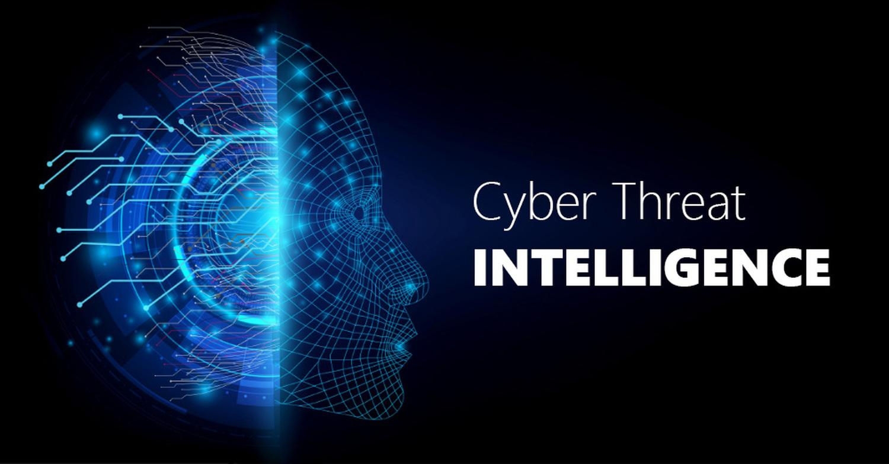
Introduction
What is Threat Intelligence?
-Knowledge that lets security teams to prevent or mitigate from Cyber Attacks.

Slide 3


Benefits of Cyber Threat Intelligence
Improves efficiency of security team
Lowering Risks
Avoid Data Breach
Collaborative Knowledge

Slide 4
Threat Intelligence Lifecycle:
Process to transform raw data into finished Intelligence for Decision making and Action.
Tip
Requirements
Collection
Processing
Analysis
Dissemination
Feedback

Slide 5
Literature Review:
Information Overload has become prevalent.
Alert overload has been done to org’s.
56% of the alerts are investigated. In that only
35% are legitimate.
Tip
Zurkus, 2015
Korolov, 2016
Qamar et al., 2017

Slide 6
Issues
Without the use of Cyber Threat Intelligence we cannot,
Prepare
Prevent
Identify Cyber Threats
Which tries to take advantage of the valuable resources.

Slide 7
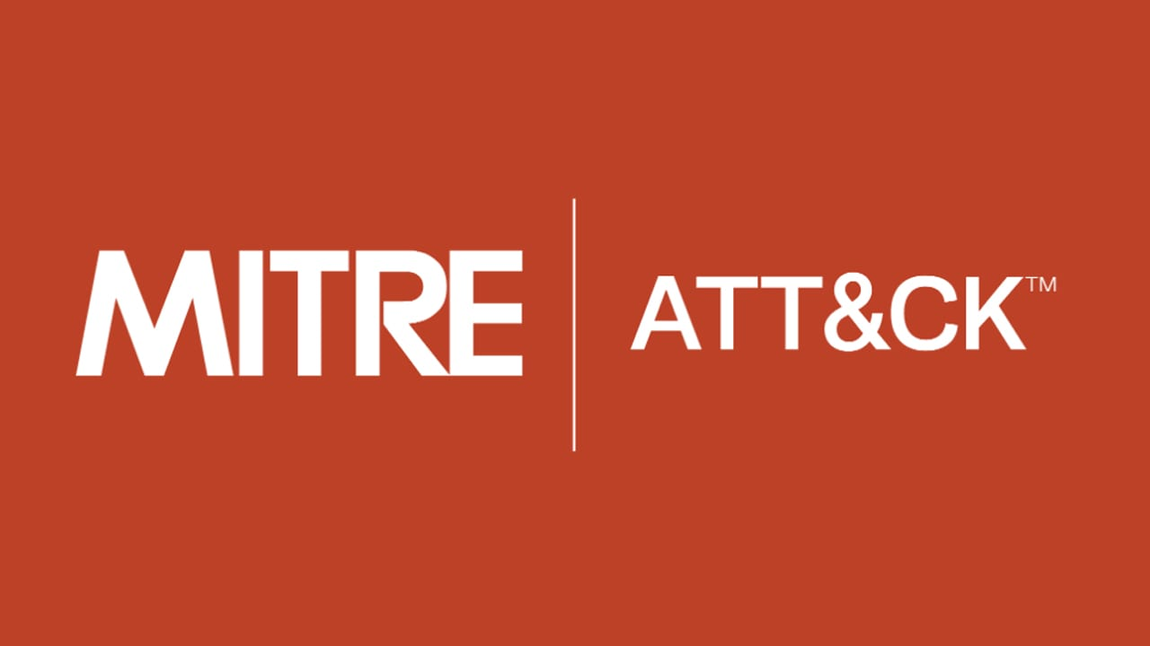
Threat Intelligence through
MITRE ATT&CK.
Tip
Globally-accessible knowledge base for Adversary Tactics and Techniques based on real world observations.
Eg. Library

Slide 8

Atomic Red Team
Library of Tests manipulated to MITRE ATT&CK framework.
Tip
1. Tests are focused and have few dependencies.
2. Structured Format that can be used by Automation framework.

Slide 9
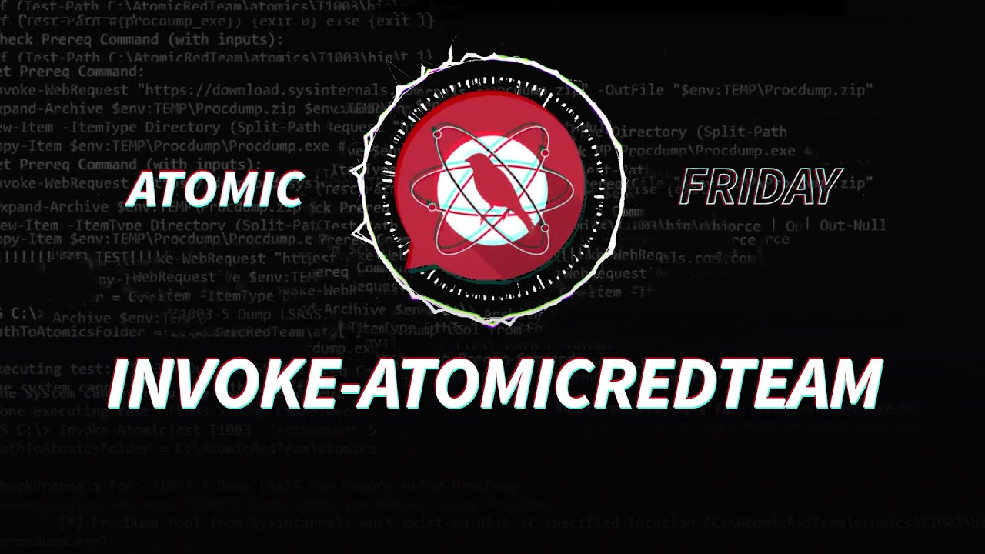
Invoke-AtomicRedTeam
Execution framework which the automates or launches Atomic Tests from Atomic Red Team
Tip
Works cross platform on windows, Mac OS, and Linux.

Slide 10
T1003 - OS Credential Dumping:
Process of obtaining account login and password information.
Tip
There are totally 8 Sub-Technique.

Slide 11


Motivation:
To measure and Improve Cyber Defence using MITRE ATT&CK.

Slide 12
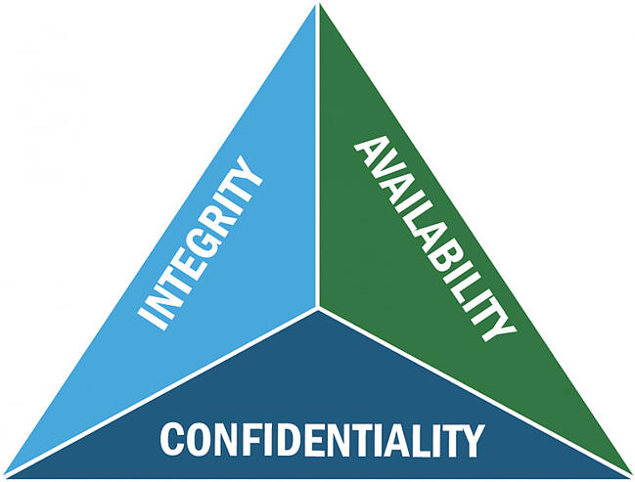
Objective
To build a system that is ready to handle cyber attacks from various adversaries.
To provide data which helps them achieve a level of protection that would be otherwise be out of reach.

Slide 13
Proposed System:
Measuring and Improving the cyber defence using Mitre ATT&CK
Tip
Build a system which handles cyber attacks and adapt for future.

Slide 14
Conclusion
Building a secure system is very important. Only then we can be strong towards the attacks which will happen in near future anytime.

Slide 15


